Slide 1
Pre-Registration and Pre-Analysis Plans
Berkeley Initiative for
Transparency in the Social Sciences
Aleksandr Michuda
Oscar Barriga Cabanillas
UC Davis Agricultural and Resource Economics
1

Slide 2
Pre-registration and pre-analysis plans:
There are numerous problems with empirical social science research, including: literatures distorted by false-positive results (Ioannidis 2005), data mining (Card and Krueger 1995), and the file drawer problem (Franco et al. 2014, Rosenthal 1979)
There are also new tools for diagnosing and quantifying these problems (i.e., Simonsohn et al 2015 p-curve, Andrews and Kasy 2017)
But how to avoid becoming part of the problem yourself?
1
Notes:
37
**
--

Slide 3
(1) Why pre-specify research hypotheses?
First of all, what is pre-registration?
1
Notes:
37
**
--

Slide 4
(1) Why pre-specify research hypotheses?
First of all, what is pre-registration?
A researcher posts her/his research hypotheses, the data used to test them, and the planned research design (i.e., methodology) in a publicly available registry
Possible to put an Embargo, so that it isn’t visible to others, but there is a record that it was registered in the past.
There is obviously a wide range of detail one could potentially include in an analysis plan (both clinicaltrials.gov and the new AEA registry allow a researcher to include relatively sparse information)
It is worth exploring the required fields in the AEA registry in a little more detail
1
Notes:
37
**
--

Slide 5
(0) What is pre-registration?
The American Economics Association (AEA) registry, socialscienceregistry.org, was founded in May 2013 with a focus on randomized control trials (RCTs).
1
Notes:
37
**
--

Slide 6
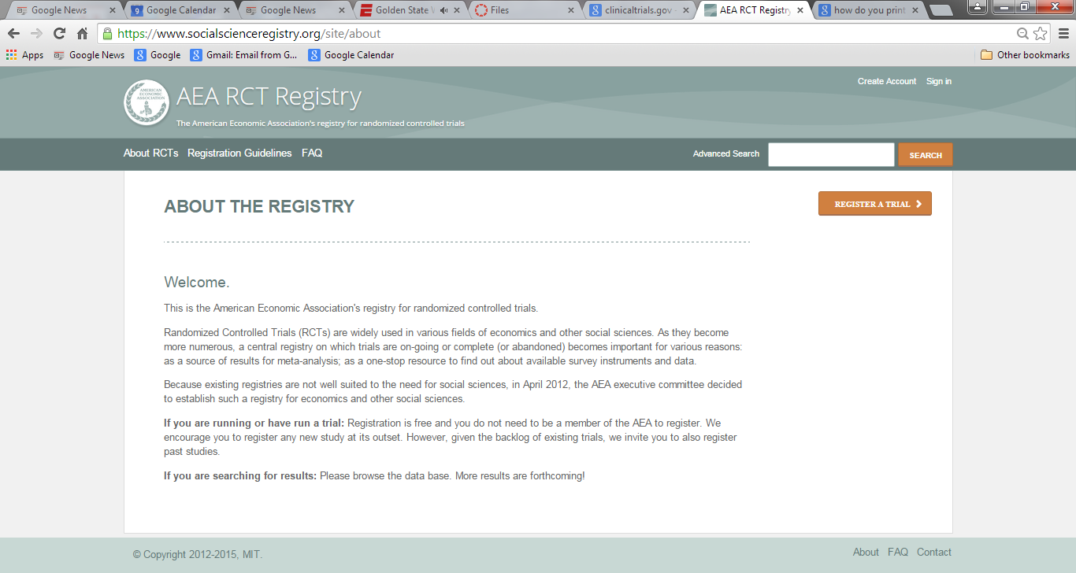
1
Notes:
37
**
--

Slide 7
(0) What is pre-registration?
The American Economics Association (AEA) registry, socialscienceregistry.org, was founded in May 2013 with a focus on randomized control trials (RCTs).
Since then over 1200 studies have been registered, and the numbers are increasing rapidly.
Some of these are earlier projects that are being registered (for completeness), but most are new studies.
1
Notes:
37
**
--

Slide 8
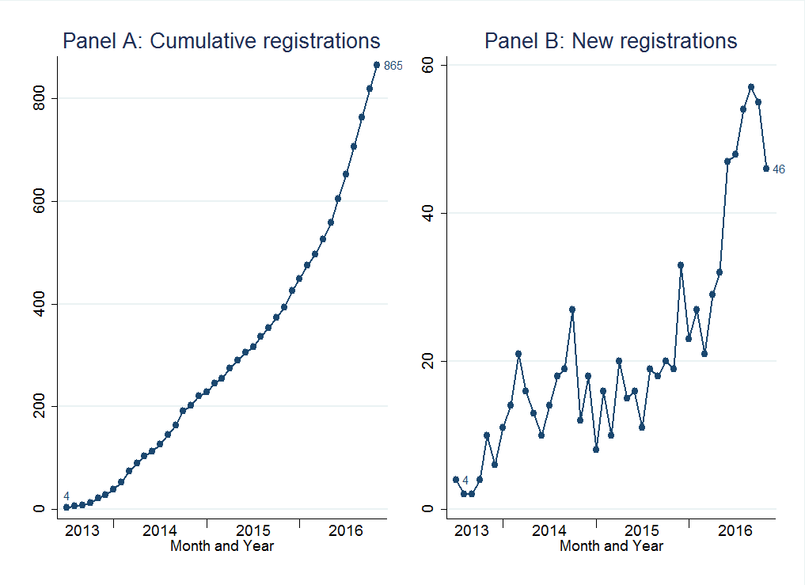
Studies in the AEA trial registry, May 2013 to September 2016.
Figure shows the cumulative (Panel A) and new (Panel B) trial registrations in the American Economics Association Trial Registry (http://socialscienceregistry.org). Figure available in public domain: http://dx.doi.org/10.7910/DVN/FUO7FC.
1
Notes:
37
**
--

Slide 9
(0) What is pre-registration?
The required information on the AEA site includes:
Trial Title; Country; Status (i.e., ongoing, completed); Keywords; Abstract; Trial Start Date; Intervention Start Date; Intervention End Date; Trial End Date; Outcomes (End Points); Experimental Design (Public); Was the treatment clustered?; Planned Number of Clusters; Planned Number of Observations; IRB approval info.
1
Notes:
37
**
--

Slide 10
(0) What is pre-registration?
You can pre-register non-RCT studies! But this is even more controversial.
You can even pre-register studies for which other people have already collected the data.
These are unconventional but they will stop you from (1) Searching over outcomes for “interesting” results. (2) Searching over models for “interesting” results. (3) *Silently* re-orienting your study once your results fail to confirm your hypothesis but a new cool unexpected finding pops up.
1

Slide 11
(1) Why pre-specify research hypotheses?
Why might pre-registration be useful?
Rounds out the body of evidence by creating a “paper trail” of unpublished studies in an area potentially helping to address publication bias (similar to Franco et al 2014) and improve meta-analysis.
1
Notes:
37
**
--

Slide 12
(1) Why pre-specify research hypotheses?
Why might pre-registration be useful?
Rounds out the body of evidence by creating a “paper trail” of unpublished studies in an area
Reduces the risk of data mining and other tendentious presentation of results (“cherry-picking”) by making clear what the authors’ original intentions and research hypotheses actually were.
1
Notes:
37
**
--

Slide 13
(1) Why pre-specify research hypotheses?
Why might pre-registration be useful?
Rounds out the body of evidence by creating a “paper trail” of unpublished studies in an area
Reduces the risk of data mining and other tendentious presentation of results (“cherry-picking”)
By making clear what additional tests were run beyond those originally planned, and thus making multiple testing adjustments more credible.
1
Notes:
37
**
--

Slide 14
(1) Why pre-specify research hypotheses?
Why might pre-registration be useful?
Rounds out the body of evidence by creating a “paper trail” of unpublished studies in an area
Reduces the risk of data mining and other tendentious presentation of results (“cherry-picking”)
Makes open data and disclosure more effective by allowing other scholars to cross-check published information against original research plans.
1
Notes:
37
**
--

Slide 15
(1) Why pre-specify research hypotheses?
Why might pre-registration be useful?
Rounds out the body of evidence by creating a “paper trail” of unpublished studies in an area
Reduces the risk of data mining and other tendentious presentation of results (“cherry-picking”)
Makes open data and disclosure more effective
As a side benefit, forces researchers to more carefully think through their hypotheses beforehand, improving research quality reducing “waste” of funding on poorly conceived projects
1
Notes:
37
**
--

Slide 16
(1) Why pre-specify research hypotheses?
Why might pre-registration be useful?
Rounds out the body of evidence by creating a “paper trail” of unpublished studies in an area
Reduces the risk of data mining and other tendentious presentation of results (“cherry-picking”)
Makes open data and disclosure more effective
As a side benefit, forces researchers to more carefully think through their hypotheses beforehand, improving research quality reducing “waste” of funding on poorly conceived projects
Helps to make correctly sized tests
Shows the exact number of hypotheses to be tested, so that MHT can be carried out.
1
Notes:
<number>
**
--

Slide 17
(1) Why pre-specify research hypotheses?
Key concern: will pre-registration stifle creativity and limit discoveries from exploratory research?
Many, if not most, important scientific findings undoubtedly originated as unexpected discoveries…
1
Notes:
<number>
**
--

Slide 18
(1) Why pre-specify research hypotheses?
Key concern: will pre-registration stifle creativity and limit discoveries from exploratory research?
Many, if not most, important scientific findings undoubtedly originated as unexpected discoveries…
But findings from such work are inherently more tentative because of the multiple testing problem.
Surprising findings should be contextualized as such!
Pre-specification is not intended to disparage exploratory analysis, but rather to free it from the tradition of being portrayed as formal hypothesis testing.
- It’s is still important, but is more tentative.
1
Notes:
<number>
**
-- The vast majority of empirical work in the social sciences today remains observational research (i.e., non-prospective) using existing data sources. As we will discuss, this is a type of research that is much more challenging to know how to pre-register. So it is likely that most empirical research will remained unregistered for the forseeable future. However, that is not an argument against pre-registering research studies when we are able to do so.

Slide 19
(2) How widely can pre-specification be applied?
A major open intellectual question.
1
Notes:
<number>
**
-- Registration rapidly gaining traction in psychology:
-- “Registered reports”, studies accepted for publication based on their research design rather than results, are being introduced in several leading journals.
-- Crowd-sourced replication projects of major findings.

Slide 20
(2) How widely can pre-specification be applied?
A major open intellectual question
Laboratory experiments: pre-analysis plans could be particularly important given the relatively low cost to researchers of running multiple experiments and never publishing the results from those that “didn’t work”
Seems like low-hanging fruit
The flip-side is that lab experiments should also be relatively low cost to replicate (Niederle 2015)
1
Notes:
<number>
** Low-hanging fruit: lab experiments.
-- Lab experimenter researchers sometimes claim that a lab “didn’t work” due to some seemingly trivial issue (i.e., the person reading the lab instructions). Or are published results actually less robust and less representative of actual findings than we think?
-- Registration rapidly gaining traction in psychology:
-- “Registered reports”, studies accepted for publication based on their research design rather than results, are being introduced in several leading journals.
-- Crowd-sourced replication projects of major findings.

Slide 21
(2) How widely can pre-specification be applied?
Prospective observational (non-experimental) studies*: One promising area is the registration of studies of anticipated policy changes.
First pre-analysis plan in Economics (to my knowledge) was Neumark’s (1999, 2001) plan to study the effect of future minimum wage increases on unemployment – discussed next.
1
Notes:
<number>
** While pre-registration cannot be used in all cases, it can be used in many settings beyond field experiments (or lab experiments).

Slide 22
(2) How widely can pre-specification be applied?
Pre-registration can also be used when new “rounds” of data are released (e.g., a new PSID wave, Census round), or where access to existing data is restricted and thus where data mining is impossible ex ante.
(What share of quantitative empirical work?)
The Open Science Framework (OSF) provides a flexible platform for time-stamping and archiving materials to be made publicly available.
(Detailed discussion next.)
1
Notes:
<number>
** While pre-registration cannot be used in all cases, it can be used in many settings beyond field experiments (or lab experiments).

Slide 23
(2) How widely can pre-specification be applied?
Beyond applied micro empirical studies: To reduce concerns about “specification search”, researchers could also pre-register:
the parameters to be used in macroeconomic calibrations (“quantitative exercises”),
the models used in structural estimation (i.e., in industrial organization), Bai et al (2015),
prior distributions used in Bayesian analysis (perhaps gathered through eliciting expert opinion).
1
Notes:
<number>
** While pre-registration cannot be used in all cases, it can be used in many settings beyond field experiments (or lab experiments).
-- Mention the case of the electrification project in Kenya, and how we specified our priors on take-up, which lets us credibly claim that we were “surprised” by the findings (i.e., much lower demand for electricity connections among rural households than we had expected).

Slide 24
(2) How widely can pre-specification be applied?
Beyond applied micro empirical studies: To reduce concerns about “specification search”, researchers could also pre-register:
the parameters to be used in macroeconomic calibrations (“quantitative exercises”),
the models used in structural estimation (i.e., in industrial organization), Bai et al (2015),
prior distributions used in Bayesian analysis (perhaps gathered through eliciting expert opinion).
1
Notes:
<number>
** While pre-registration cannot be used in all cases, it can be used in many settings beyond field experiments (or lab experiments).
-- Mention the case of the electrification project in Kenya, and how we specified our priors on take-up, which lets us credibly claim that we were “surprised” by the findings (i.e., much lower demand for electricity connections among rural households than we had expected).

Slide 25
(3) Neumark (1999, 2001)
This paper is a (largely forgotten) milestone in social science research methodology
To my knowledge, first pre-analysis plan in Economics
Study of the highly contentious (and politicized) issue of labor market impacts of minimum wage increases
1
Notes:
<number>
** The only economics study of which we are aware that has used a pre-analysis plan on non-experimental data was undertaken in Neumark (2001). Based on conversations with David Levine, Alan Krueger appears to have suggested to Levine, who was the editor of the Industrial Relations journal at the time, that multiple researchers could analyze the employment effects of an upcoming change in the federal minimum wage with pre-specified research designs, in a bid to eliminate “author effects,” and that this could create a productive “adversarial collaboration” between authors with starkly different prior views on the likely impacts of the policy change (Levine 2001). (The concept of adversarial collaboration—two sets of researchers with opposing theories coming together and agreeing on a way to test hypotheses before observing the data—is often associated with Daniel Kahneman, see, for example Bateman et al. 2005).
The minimum wage increased in October 1996 and September 1997. Although Krueger ultimately decided not to participate, Neumark submitted a pre-specified research design consisting of the exact estimating equations, variable definitions, and subgroups that would be used to analyze the effect of the minimum wage on the unemployment of younger workers using October, November, and December Current Population Survey (CPS) data from 1995 through 1998. This detailed plan was submitted to journal editors and reviewers prior to the end of May 1997; the October 1996 data started to become available at the end of May 1997, and Neumark assures readers he had not looked at any published data at the state level prior to submitting his analysis plan.
The verifiable “time stamp” of the federal government’s release of data indeed makes this approach possible, but the situation also benefits from the depth and intensity of the minimum wage debate prior to this study. Neumark had an extensive extant literature to draw upon when choosing specific regression functional forms and subgroup analyses. He tests two definitions of the minimum wage, the ratio of the minimum wage to the average wage (common in Neumark’s previous work) as well as the fraction of workers who benefit from the newly raised minimum wage (used in David Card’s earlier work, Card 1992a and Card 1992b), and tests both models with and without controls for the employment rate of higher-skilled prime age adults (as recommended by Deere, Murphy, and Welch 1995). The results mostly fail to reject the null hypothesis of no effect of the minimum wage increase: only 18 of the 80 specifications result in statistically significant decreases in employment (at the 90% confidence level), with estimated elasticities ranging from -0.14 to -0.3 for the significant estimates and others closer to zero.
A more recent study bases its analysis on Neumark’s exact pre-specified tests estimate the effect of minimum wages in Canada and found larger unemployment effects, but they had access to the data before estimating their models and did not have an agreement with the journal, so the value of this “pre-specification” is less clear (Campolieti, Gunderson, and Riddell 2006). In political science, a pre-specified observational analysis measured the effect of the immigration stances of Republican representatives on their 2010 election outcomes (Monogan 2013).
It is difficult to see how a researcher could reach Neumark’s level of pre-specified detail with a research question with which they were not already intimately familiar. It seems more likely that in a case where the researcher was less knowledgeable they might either pre-specify with an inadequate level of detail, or choose an inappropriate specification; this risk makes it important that researchers should not be punished for deviating from their pre-analysis plan in cases where the plan omits important details or contains errors, as argued in Casey et al (2012).
It seems likely to us that the majority of observational empirical work in economics will continue largely as is for the forseeable future. However, for important, intensely debated, and well-defined questions, it would be desirable in our view for more observational research to be conducted in a pre-specified fashion, following the example in Neumark (2001). Although pre-specification will not always be possible, the fact that large amounts of government data are released to the public on regular schedules, and that many policy changes are known to occur well in advance (such as in the case of the anticipated federal minimum wage changes discussed above), will make it possible for the verifiable pre-specification of research analysis to be carried out in many settings.

Slide 26
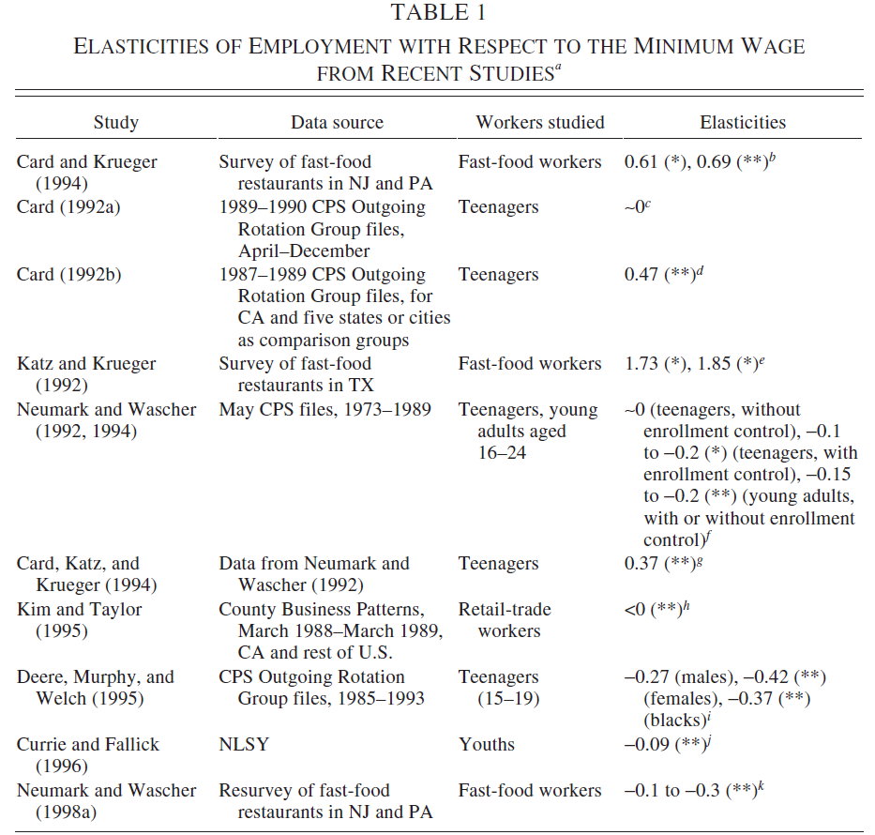
(3) Neumark (1999, 2001)
Potentially
considerable
variation in
estimated effects,
so chosen
methodology
will potentially
matter!
1
Notes:
<number>
** Mention that since this time, over 100 empirical studies of employment impacts of the minimum have been carried out, and recent meta-analysis (which I do not know well, admittedly) suggests that the average effect on employment is between -0.1 and -0.2. In other words, for every 10% increase in the minimum wage, employment falls by 1-2%, a small effect.
-- How much of this variation in estimates is due to author effects and specification search effects, how much is due to publication bias, and how much is simply due to inherent heterogeneity in treatment effect impacts in different settings (by time and place)?
--

Slide 27
(3) Neumark (1999, 2001)
Solution (in the absence of a study registry): submitted a detailed analysis plan to a journal (Industrial Relations) before the release of the relevant U.S. government employment statistics (in May 1997)
Received referee reports and revised the analysis plan before receiving the data
1
Notes:
<number>
**
-- Here the journal editor serves as the registry (of sorts), he can vouch for the original article submission.
--

Slide 28
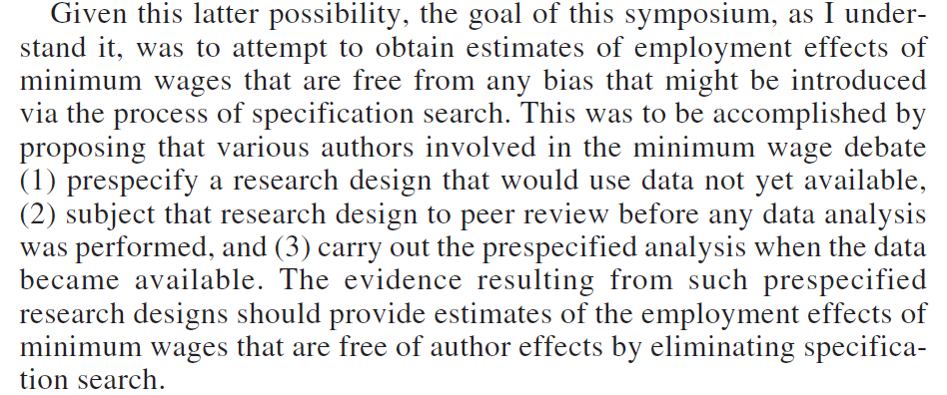
(3) Neumark (1999, 2001)
(p. 123)
1
Notes:
<number>
**
-- Here the journal editor (David Levine) serves as the registry (of sorts), he can vouch for the original article submission.

Slide 29
1
Notes:
<number>
**
-- Here the journal editor serves as the registry (of sorts), he can vouch for the original article submission.
-- This was all carried out 20 years ago in Economics. Why hasn’t it been done since? The logistics do not seem unsurmountable.
--

Slide 30
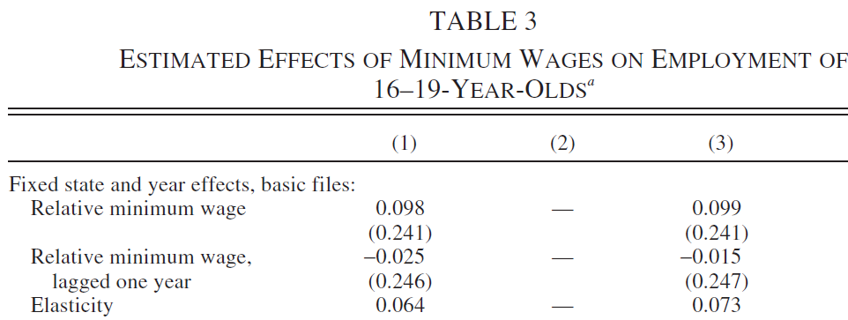
(3) Neumark (1999, 2001)
What did Neumark find? No statistically significant effects
and small magnitudes, somewhere in middle of existing
estimates. But analysis appears under-powered (large SE’s)
1
Notes:
<number>
**

Slide 31
Registered Reports
Similar to a pre-analysis plan, but needs the backing of journal
A journal peer reviews a research design a questions to be asked before data is collected.
Upon satisfactory and rigorous carrying out of data collection, paper is published regardless of results
Helps cut down on the file drawer problem.
Currently 156 journals use Registered Reports (including JDE)
Similar to a pre-analysis plan, but needs the backing of journal
A journal peer reviews a research design a questions to be asked before data is collected.
Upon satisfactory and rigorous carrying out of data collection, paper is published regardless of results
Helps cut down on the file drawer problem.
Currently 156 journals use Registered Reports (including JDE)

Slide 32
JDE Registered Reports
JDE has started a pilot Registered Reports project (partially funded by BITSS)
Breaks up publishing into two stages
Stage 1: Peer Review before data collection/analysis
Stage 2: Review of quality of implementation and publication

Slide 33
Stage 1
Editorial Board reviews for completeness and scope (as in regular publications)
Then gets sent for peer review
Importance of research question
Replicability
Pre-specified hypotheses
Data quality checks
If accepted, Stage 1 will become supplementary material for the Stage 2 Paper

Slide 34
Between Pre-Results Acceptance and Stage 2
Data collection keeping in mind that data will be posted online (with some caveats)
Stage 1 can be withdrawn at any time
Deviations from Stage 1 should be documented and included in Stage 2 manuscript.

Slide 35
Stage 2
The paper with results
All prespecified hypotheses must be included
Exploratory analysis can be included but must be designated as such.
Stage 2 reviewers are same as Stage 1, but they can invite new ones as well.

Slide 36
Stage 2 Review
Was it implemented according to the research design prespecified in Stage 1
Is data of sufficient quality to test hypotheses
Power?
Data checks made?
Were deviations justified?
Exploratory analysis justified?
Is author’s interpretation consistent with data and findings?
Editorial Decisions will not be based on perceived importance, novelty or conlusiveness of results.

Slide 37
Hands-on
To start a preregistration, go to:
https://osf.io/prereg/

Slide 38
Thank you!

